Slide 1

Use Case of BIG DATA in Oil and Gas Industry -Baker Hughes, a GE Company
Presented by:
Harish Fegade
Image Source - http://ncentric.com/industries/oil-gas

Slide 2

Agenda
BHGE Overview
Oil & Gas Industry Overview
Big Data in Oil & Gas Industry
AI application and tools used
Impact of Big Data
https://en.wikipedia.org/wiki/Baker_Hughes
https://in.linkedin.com/company/bhge

Slide 3

BHGE - Overview
Founded in 1908 by Walter Benona Sharp and Howard R Hughes, Sr.
BHGE is 17.26 billion USD company (FY 2017)
BHGE is the Oil Field Services company.
It operates in 120 countries, providing oil and gas industry with products and services for oil drilling, formation evaluation, completion, production & reservoir consulting.
https://en.wikipedia.org/wiki/Baker_Hughes
https://in.linkedin.com/company/bhge

Slide 4
Oil & Gas Industry
Global Market Size – 5.5 trillion USD
The world consumes 105 billion barrels of oil per year, with developed nations being the largest consumers.
The oilfield services market is expected to grow from USD 106.43 Billion in 2017 to USD 125.51 Billion by 2022, registering a CAGR of 3.35%, from 2017 to 2022.
http://www.visualcapitalist.com/size-oil-market/
https://www.statista.com/statistics/236657/global-crude-oil-reserves-since-1990/
https://www.marketsandmarkets.com/PressReleases/oilfield-services.asp

Slide 5
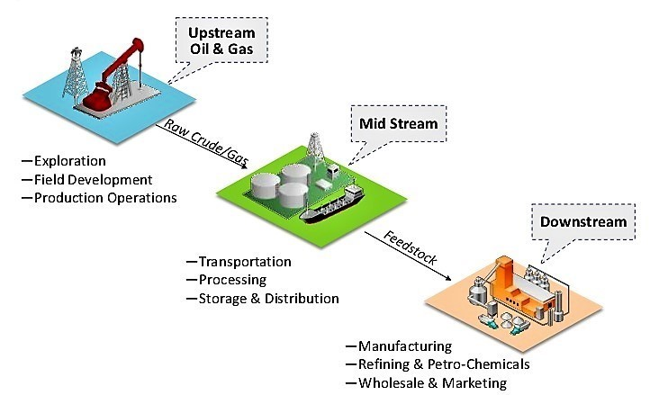
Fullstream Process
Image Source - https://resources.infosecinstitute.com/oil-and-gas-cyber-security-101/#gref
https://blogs.nvidia.com/blog/2018/01/29/baker-hughes-ge-nvidia-ai/

Slide 6
Challenges in Oil & Gas Industry
Understand the most viable areas to explore the underground hydrocarbons with potentially greatest returns.
Reservoir production over time.
Maximize the operational efficiency while meeting the environmental standards.
Optimizing the time and cost of delivering the parts, supplies and personnel needed at exploration and production sites.
https://en.wikipedia.org/wiki/Oil_well
http://www.oracle.com/us/technologies/big-data/big-data-oil-gas-2515144.pdf

Slide 7
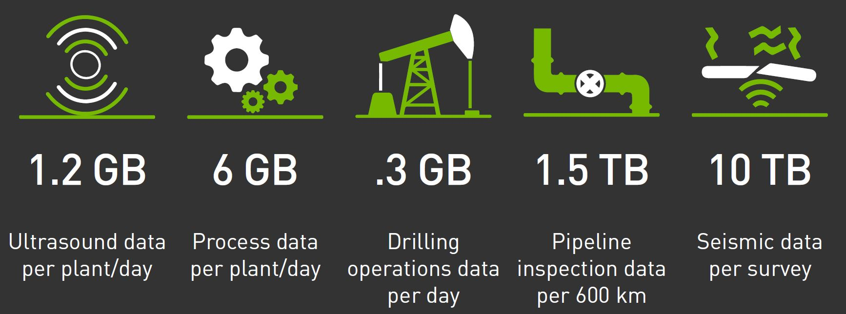
How Big is Big Data in Oil and Gas Industry
Data from sensors during oil and gas drilling exploration, production, transportation, and refining.
Social Media
Web browsing patterns on informational websites
Demographic data
Historical oil & gas exploration, delivery, and pricing data
Image Source - https://www.nvidia.com/content/dam/en-zz/Solutions/Data-Center/dgx-1/dl-oil-n-gas-bhge-infographic.pdf
http://www.oracle.com/us/technologies/big-data/big-data-oil-gas-2515144.pdf

Slide 8

How do they do it?
BHGE is partnering with NVIDIA to use AI and GPU accelerated computing to help Oil & Gas Industry reduce overall operational costs.
https://blogs.nvidia.com/blog/2018/01/29/baker-hughes-ge-nvidia-ai/

Slide 9


Tools used for Field Planning Optimization:
JewelSuite™ Subsurface Modelling
JewelSuite™ Geomechanics
Gives a rich understanding of oil reservoir to position wells properly, construct them effectively, and accurately predict recovery.
Identify Risks
Mitigate Control Issues
Improve Assessments
https://www.bhge.com/digital/field-planning-optimization/jewelsuitetm-subsurface-modeling
https://www.bhge.com/digital/field-planning-optimization/jewelsuite-geomechanics

Slide 10
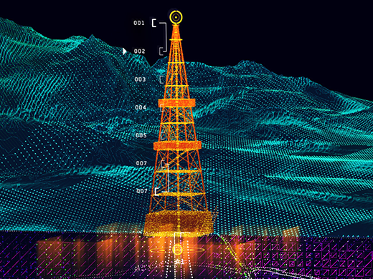

Tools used for Field Planning Optimization:
JewelSuite™ Reservoir Stimulation
JewelSuite™ Viewer
It helps with 3D visualization of different scenarios & wells and different designs of the layout.
A single View of data
Accelerated Decision Making
https://www.bhge.com/digital/field-planning-optimization/jewelsuitetm-viewer
https://www.bhge.com/digital/field-planning-optimization/jewelsuite-reservoir-stimulation

Slide 11
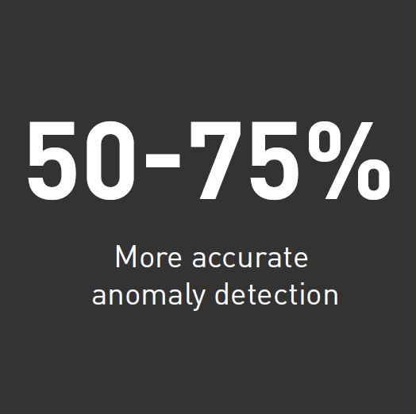
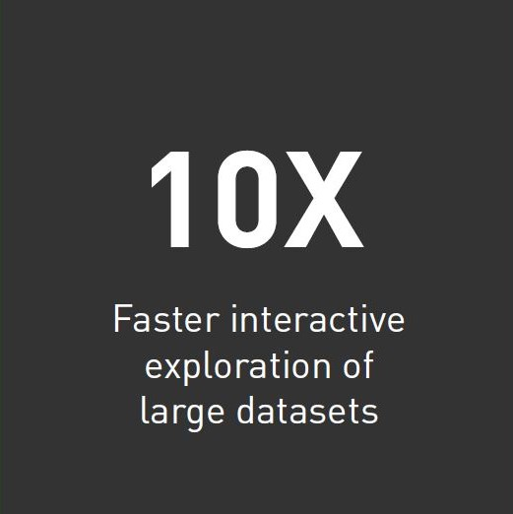
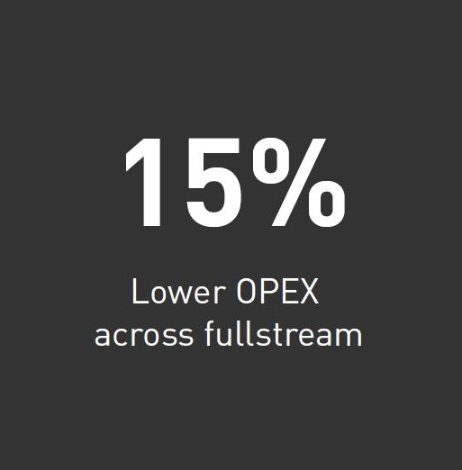
Impact of Big Data
“Calibration of the wells—a process that usually takes weeks to complete—took just minutes”
– Mr. Arun Subramaniyan, V.P. of Data Science & Analytics at BHGE.
https://www.nvidia.com/content/dam/en-zz/Solutions/Data-Center/dgx-1/dl-oil-n-gas-bhge-infographic.pdf
https://www.worldoil.com/conference-news/2018/6/14/bhge-s-unify-makes-the-case-for-digital-technology-in-og-saying-we-can-do-better

Slide 12

Thank you
Image Source - http://labtestcert.com/wp-content/uploads/2013/04/shutterstock_889562621.jpg

